Slide 1
Advanced CNNs
AI ToolKit
Fall Semester, 2023
Reference: mml-book.github.io && d2l.ai
Notes:
How can summarize matrices, how matrices can be decomposed.

Slide 2

Convolutional Neural Networks : possible question
Okay, now we know what are convolution, pooling, activation layers.
But how can we construct a “good” CNN based network structure?
=> There are models which are shown to be successful in ImageNet classification task!

Slide 3
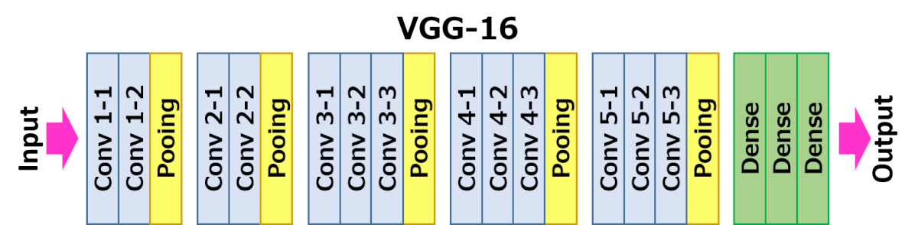
Convolutional Neural Networks : possible question
Okay, I got the model structure that has been shown as successful in ImageNet classification task.
What should I do now?
My task is related to different image dataset!
Image credit : https://neurohive.io/en/popular-networks/vgg16/

Slide 4
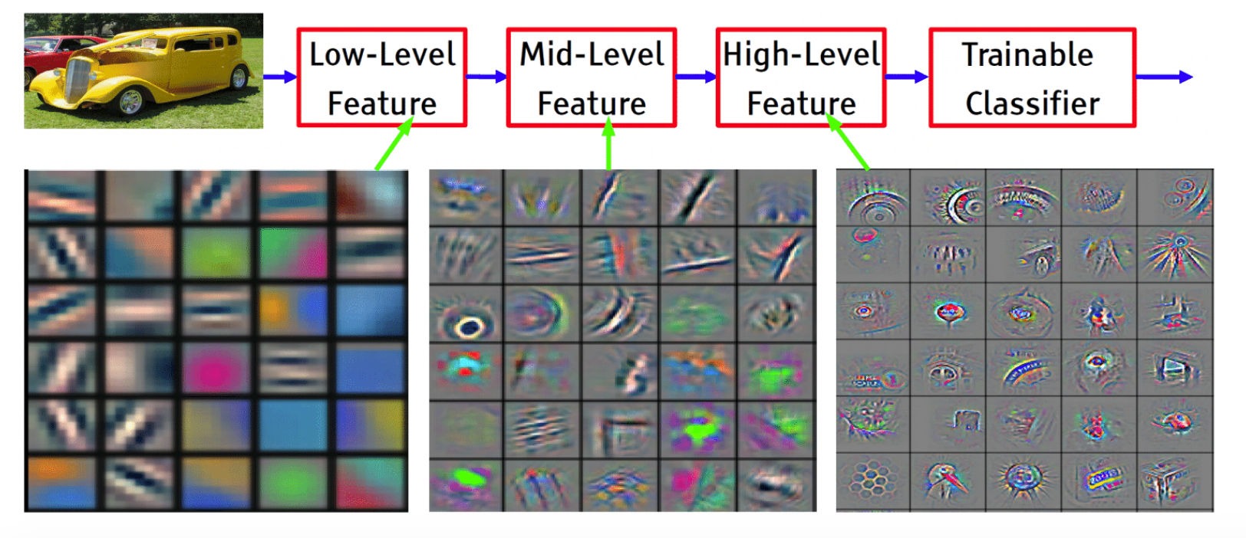
Deep learning is about learning representations
Successful models on the ImageNet classification task have learned how to extract meaningful representation from images!
Image from https://sailinglab.github.io/pgm-spring-2019/notes/lecture-16/

Slide 5
Deep learning is about learning representations
ex) re-define the last Fully Connected Layer, and only train the last part!
Fix this part, which would have learned how to extract meaningful features from the input images!
Successful models on the ImageNet classification task have learned how to extract meaningful representation from images!
Image credit : https://neurohive.io/en/popular-networks/vgg16/

Slide 6
Deep learning is about learning representations
Or, choose how much to fix the initial part for feature extraction
Successful models on the ImageNet classification task have learned how to extract meaningful representation from images!
Image credit : https://neurohive.io/en/popular-networks/vgg16/

Slide 7
Deep learning is about learning representations
Or, choose how much to fix the initial part for feature extraction
Successful models on the ImageNet classification task have learned how to extract meaningful representation from images!
Image credit : https://neurohive.io/en/popular-networks/vgg16/

Slide 8
Convolutional Neural Networks : possible question
Okay, I got the model structure that has been shown as successful in ImageNet classification task.
What should I do now?
My task is not about the image classification! But I want to get some features of images.
Image credit : https://neurohive.io/en/popular-networks/vgg16/

Slide 9
Deep learning is about learning representations
Only use the initial part for the your feature extraction!
Image credit : https://neurohive.io/en/popular-networks/vgg16/

Slide 10
Deep learning is about learning representations
Get output feature and use it for your another task!
Only use the initial part for the your feature extraction!
Image credit : https://neurohive.io/en/popular-networks/vgg16/

Slide 11
Deep learning is about learning representations
If you want spatial (D x H x W) feature...
Image credit : https://neurohive.io/en/popular-networks/vgg16/

Slide 12
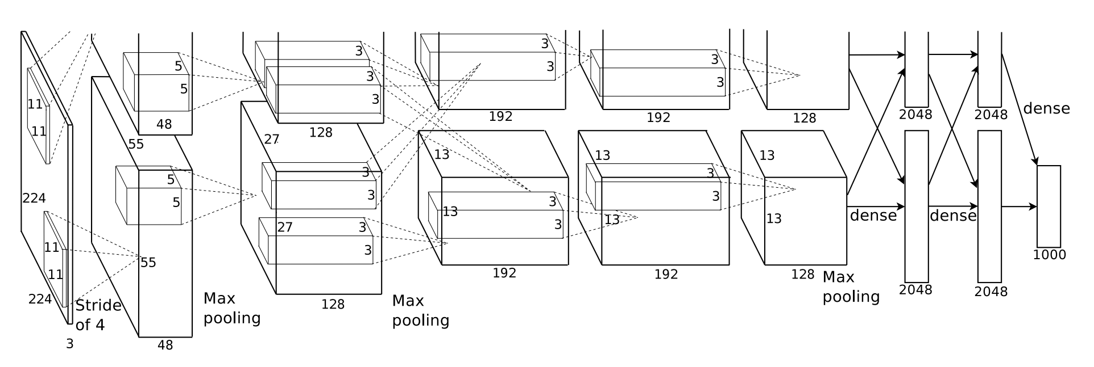
Famous Structures : AlexNet
Image credit : original paper (https://proceedings.neurips.cc/paper/2012/hash/c399862d3b9d6b76c8436e924a68c45b-Abstract.html)

Slide 13
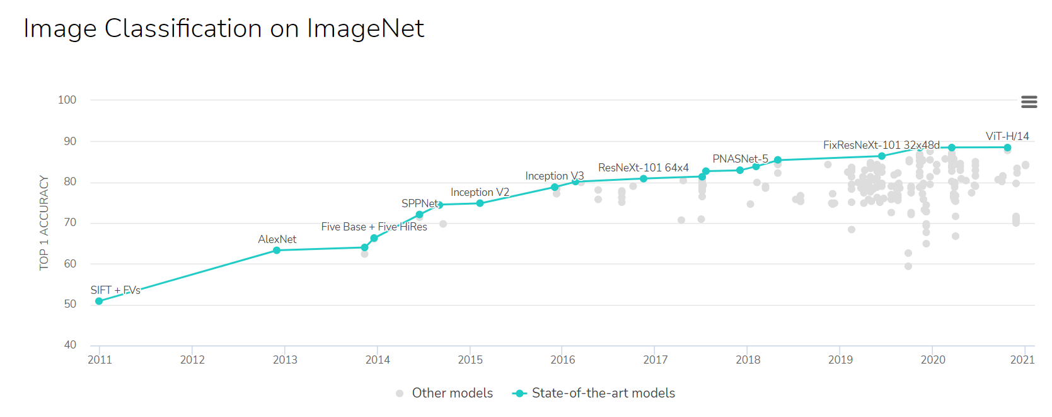
Famous Structures : AlexNet
Image credit : original paper (https://paperswithcode.com/sota/image-classification-on-imagenet)

Slide 14
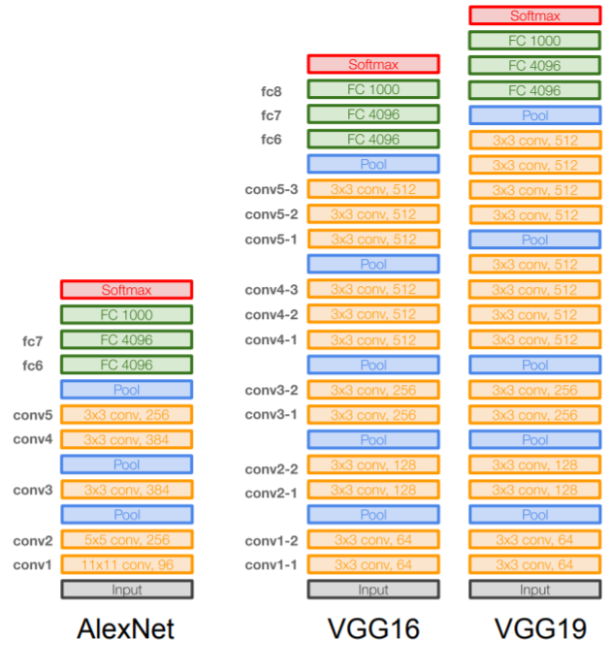
Famous Structures : VGG Net
Small Filters (3x3), and Deeper Network
Stack of three 3x3 conv (stride 1) layers has same effective receptive field as one 7x7 conv layer!
Slide credit : http://cs231n.stanford.edu/slides/2020/lecture_9.pdf

Slide 15
Famous Structures : VGG Net
Small Filters (3x3), and Deeper Network
Stack of three 3x3 conv (stride 1) layers has same effective receptive field as one 7x7 conv layer!
Deeper Layers with more non-linearities
And Less Parameters
Slide credit : http://cs231n.stanford.edu/slides/2020/lecture_9.pdf

Slide 16
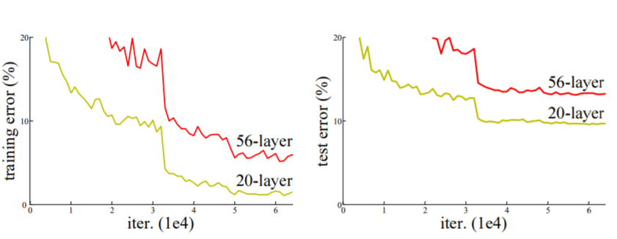
Can we construct deeper CNNs…?
Image credit : https://arxiv.org/pdf/1512.03385.pdf

Slide 17
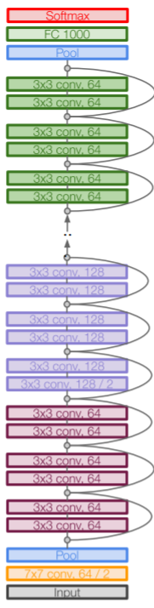
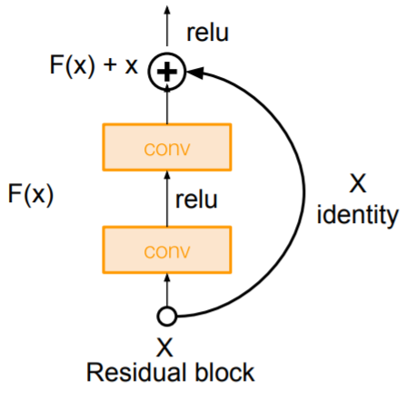
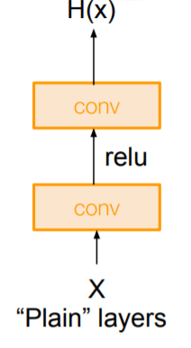
Famous Structures : ResNet
Slide credit : http://cs231n.stanford.edu/slides/2020/lecture_9.pdf

Slide 18
Famous Structures : ResNet
``......Formally, denoting the desired underlying mapping as H(x), we let the stacked nonlinear layers fit another mapping of F(x) := H(x)−x. The original mapping is recast into F(x)+x. We hypothesize that it is easier to optimize the residual mapping than to optimize the original, unreferenced mapping…..’’
Slide credit : http://cs231n.stanford.edu/slides/2020/lecture_9.pdf

Slide 19
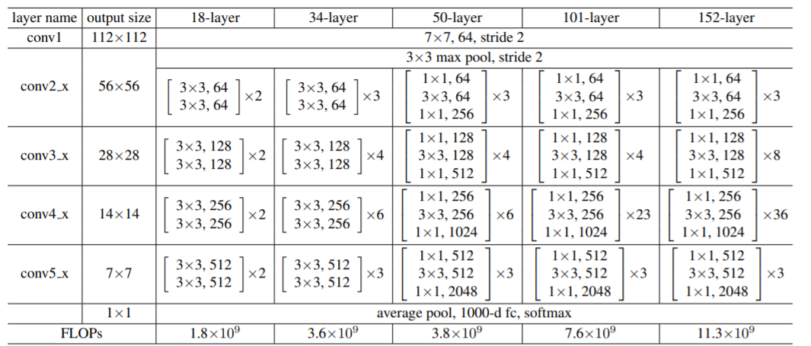
Famous Structures : ResNet
Table from : https://arxiv.org/pdf/1512.03385.pdf

Slide 20
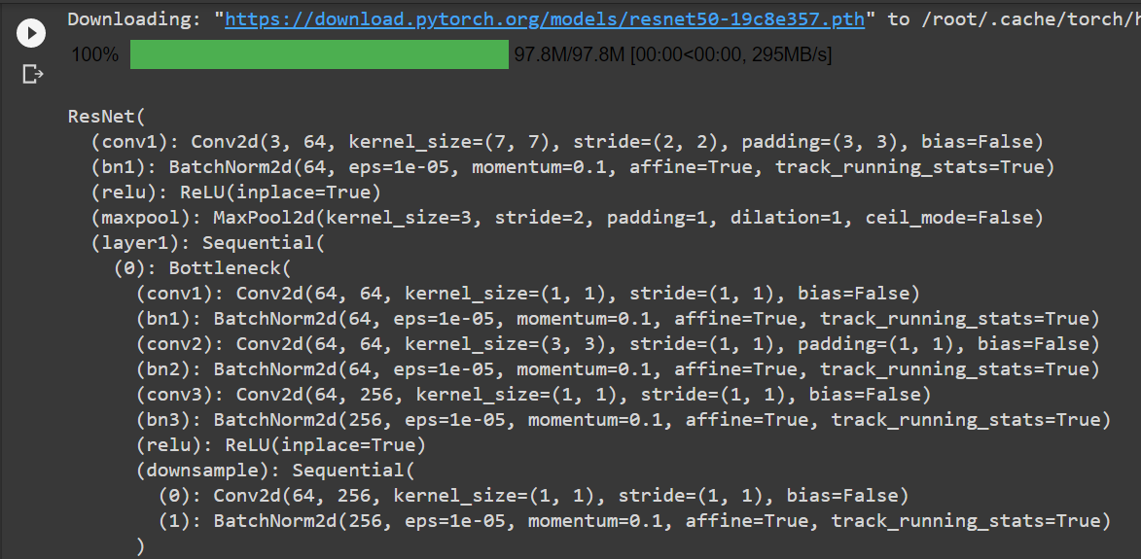
Famous Structures : ResNet
Slide credit : http://cs231n.stanford.edu/slides/2020/lecture_9.pdf

Slide 21
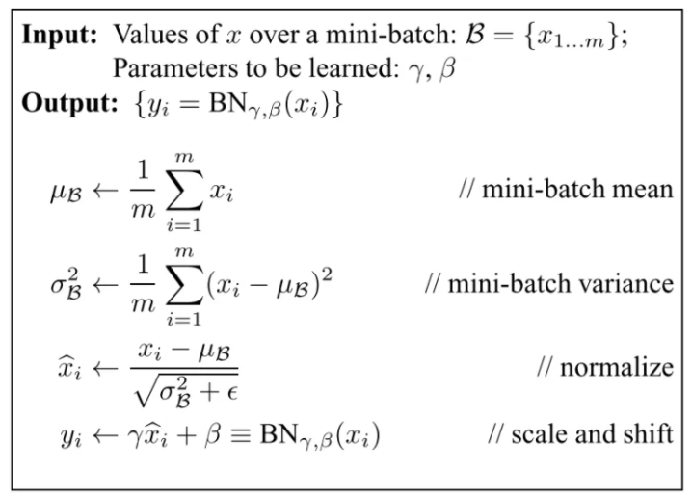
What is Batch Normalization?
- To prevent the input distribution from changing in each step of the neural network
Not to make each layer to keep adapting to its changing inputs.
- Usually inserted after Fully Connected or Convolutional layers, and before nonlinearity (CONV - BN - RELU…)
- Improves gradient flow
- Allows higher learning rates
- Faster convergence
https://mlexplained.com/2018/01/10/an-intuitive-explanation-of-why-batch-normalization-really-works-normalization-in-deep-learning-part-1/
Image from : https://arxiv.org/pdf/1502.03167.pdf

Slide 22
What is Batch Normalization?
Can this calculated in the test time?
In test time, we use (running) average values seen during training.
Image from : https://arxiv.org/pdf/1502.03167.pdf

Slide 23
Any Questions?

